Slide 1
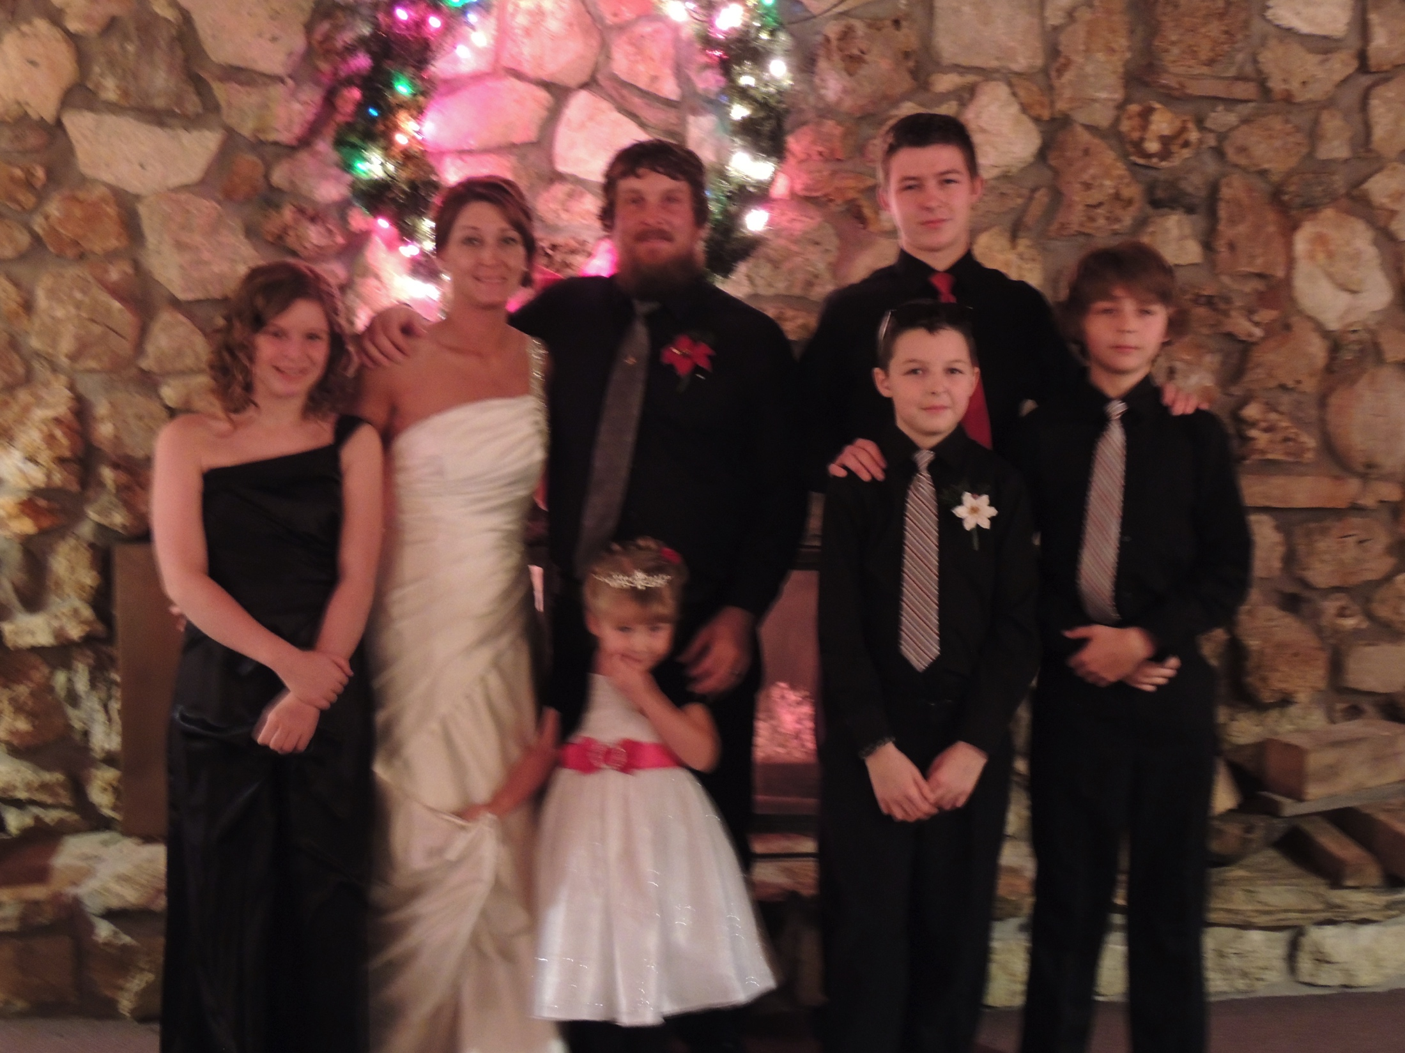
Welcome!
Mrs. Jones-Hauschild

Slide 2
Classroom Rules
Respect Each Other
Respect the equipment
Be on Time
Be Prepared
My classroom rules are simple:
Be Respectful to everyone and everything
When I am speaking you are not speaking. Give me the courtesy of listening when I speak and I will return the favor to you when it is your turn to speak
Be kind to one another!

Slide 3
Helpful Hints
Use your rubrics! If I provide you a rubric for an assignment (and I will most of the time), use it! The rubric will spell out for you how to earn the points you need to receive a good grade.
Stay organized! Have a notebook and a three ring binder available for this class in order to keep you organized.

Slide 4
Introduction to Business 9-12 Business Lab
Textbook
Intro to Business; 6th edition, Eggland, Dlabay, and Burrow. Other outside sources and projects created by Mrs. Hauschild
Class Overview:
This course will expose students to various aspects of the business world. Students will also be exposed to various careers in business. There will be many hands-on activities, technology based projects and case studies during this course.

Slide 5
Intro. To Business
Topics to be covered:
Our economic environment
Business operations
Business and government in our global economy
Small –business management
Technology in the business world
Consumers in our economy
Financial institutions/banking services
Insurance
Money management

Slide 6
Grading
Grades will be based on the student’s performance in the following areas:
Daily assignments
Class participation
Quizzes
Exams
Projects/reports
Career projects
Meeting deadlines
Attitude

Slide 7
Grading Scale
A 95 to 100
A- 92 to 94
B+ 90 to 91
B 85 to 89
B- 82 to 84
C+ 80 to 81
C 75 to 79
C- 72 to 74
D+ 70 to 71
D 65 to 69
D- 62 to 64
F Below 62
***The semester test will be 20% of your overall semester grade.***

Slide 8
Business Keyboarding
Textbook
Century 21 Keyboarding, Formatting, and Document Processing. Mrs. Hauschild may create outside sources to use periodically

Slide 9
Lessons/Class Projects
Review the parts of the computer and how to care for storage devices
Review and master the proper keyboarding techniques
Review some basic computer terminology
Review all the keys on the computer
Business Letter Unit
Business Report Unit
Office Simulations/Office etiquette
Composing Unit
Various projects incorporated into different units

Slide 10
Materials
Pen or pencil,
Flash drive

Slide 11
Grading
Grades will be based on:
Daily participation
Daily assignments
Quizzes
Exams
Projects
Speed/accuracy

Slide 12
Grading Scale
Grading Scale
A 100%-95%
A- 94%-92%
B+ 91%-90%
B- 84%-82%
C+ 81%-80%
C 79%-75%
C- 74%-72%
D+ 71%-70%
D 69%-65%
D- 64%-62%
F 61% and below

Slide 13
Publications (Yearbook)
Course Overview:
This class is responsible for the production of the school yearbook. Through instruction in this course, the student will learn how to operate a digital camera, use various computer software programs, become familiar with the materials needed to prepare a publication, arrange eye-appealing materials, create and format various business documents, and learn to work with his/her peers in a dependable, responsible manner.

Slide 14
Website and School Code?
?
?

Slide 15
Grading
Your grade will be based on:
Daily Grade (5points possible each day)
Photos
Page Layouts
Meeting Deadlines
Proofing
Photo Boards
Classroom Management: working as a team, being organized, asking questions, helping others, etc.
Some outside of class work (taking photos, interviews, gathering information, page design
Ad sales
Quarter Projects

Slide 16
Grading Scale
A 100%-95%
A- 94%-92%
B+ 91%-90%
B- 84%-82%
C+ 81%-80%
C 79%-75%
C- 74%-72%
D+ 71%-70%
D 69%-65%
D- 64%-62%
F 61% and below

Slide 17
Digital Cameras
I have several digital cameras. You will be checking them out on a regular basis. When you check out a camera you need to sign it out on the back sign out sheet. When you return the camera, Mrs. Hauschild needs to sign it back in. Each week you will be responsible for taking and uploading at least 20 pictures to the yearbook site and putting them in the correct folder.

Slide 18
Page Assignment
Mrs. Hauschild will be assigning each of you pages to complete. It will be your responsibility to complete your assigned pages. You will be able to work with a partner on some pages

Slide 19
Accounting I
Text Book:
Century 21 Accounting
Other outside sources will be used
Lessons/Class Projects:
General accounting terms
Accounting concepts
Financial Statements
Debit/Credits with Normal Balances
Learn accounting practices for partnerships and proprietorships

Slide 20
Material needed for class
Everyday the student must bring their textbook, workbook notebook, folder and pen or pencil to class

Slide 21
Grading
Grades will be based on the student’s performance in the following areas:
Daily assignments/workbook problems
Quizzes
Exams
Projects/Reports
Class Particiapation

Slide 22
Grading Scale
A 100%-95%
A- 94%-92%
B+ 91%-90%
B- 84%-82%
C+ 81%-80%
C 79%-75%
C- 74%-72%
D+ 71%-70%
D 69%-65%
D- 64%-62%
F 61% and below

